Slide 1

AI-Powered Email Spam Detection Using Machine Learning
Leveraging advanced machine learning algorithms to protect inboxes from evolving threats
NAME : R. Vamsi
REG.NO : 323129512047

Slide 2

The Escalating Spam Challenge
Email spam continues to evolve, with attackers deploying increasingly sophisticated techniques to bypass traditional filters. Modern spam campaigns leverage social engineering, polymorphic content, and coordinated bot networks.
Traditional rule-based systems struggle to keep pace with these adaptive threats, creating an urgent need for intelligent, self-learning detection mechanisms.

Slide 3




Why Machine Learning Transforms Detection
Pattern Recognition
Adaptive Learning
ML models identify subtle patterns across millions of emails that humans and rules cannot detect
Systems continuously evolve by learning from new spam tactics in real-time
Precision Classification
Real-Time Processing
Advanced algorithms achieve 99%+ accuracy while minimizing false positives
Models analyze and classify thousands of emails per second at scale

Slide 4




Core ML Techniques for Spam Detection
Natural Language Processing
Tokenization, stemming, and semantic analysis extract meaningful features from email content and headers
Classification Algorithms
Naive Bayes, Random Forest, and SVM models categorize emails based on learned feature patterns
Deep Learning Networks
LSTM and transformer models capture complex contextual relationships and sequential patterns
Ensemble Methods
Multiple model architectures combined for superior accuracy and robustness against adversarial attacks

Slide 5

Feature Engineering: The Foundation
1
2
Content Features
Metadata Features
Word frequency, n-grams, special characters, URL patterns, and HTML structure analysis
Sender reputation, domain age, SPF/DKIM/DMARC validation, and header authentication
3
Behavioral Features
Sending patterns, recipient lists, attachment types, and historical interaction data

Slide 6
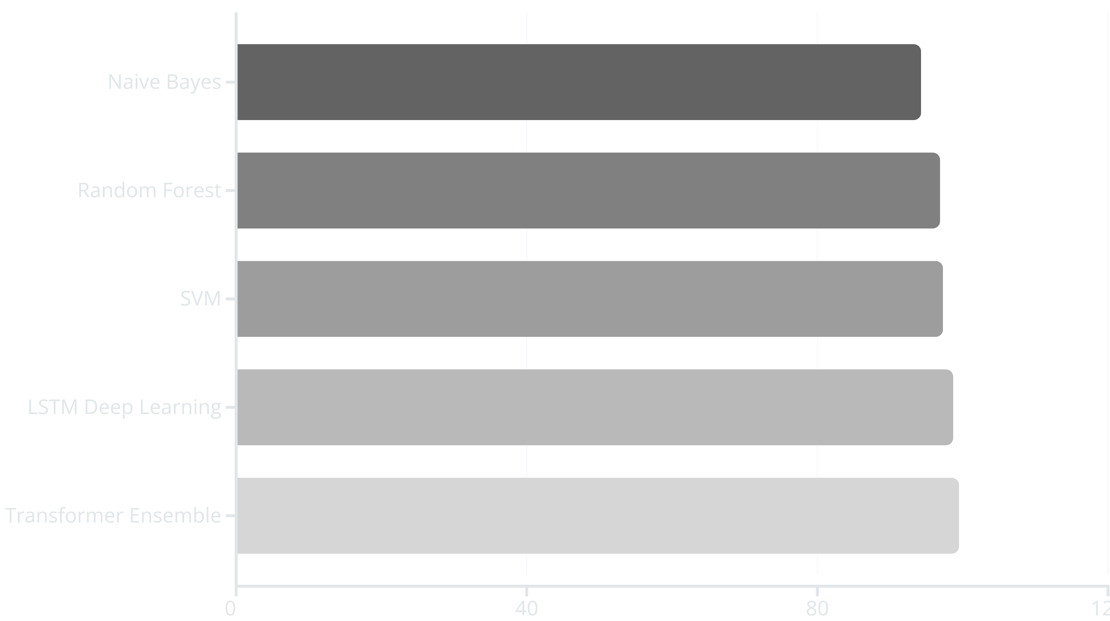
Model Performance Comparison
Accuracy rates across different ML algorithms on a standardized email corpus of 50,000 messages
Ensemble methods combining multiple architectures deliver the highest accuracy with minimal false positives.

Slide 7

Implementation Architecture
01
Data Ingestion Pipeline
Real-time email stream processing with distributed message queues
02
Feature Extraction Layer
Parallel processing of text, metadata, and behavioral signals
03
Model Inference Engine
GPU-accelerated prediction serving with sub-100ms latency
04
Feedback Loop
Continuous model retraining with labeled data from user actions

Slide 8
Key Challenges & Solutions
Adversarial Attacks
False Positive Reduction
Scalability Requirements
Challenge: Spammers deliberately craft messages to evade detection algorithms
Challenge: Legitimate emails misclassified as spam damage user trust and productivity
Challenge: Processing millions of emails daily with minimal latency
Solution: Adversarial training and robust feature engineering that focuses on invariant patterns
Solution: Distributed computing, model optimization, and tiered filtering strategies
Solution: Confidence thresholding, whitelist integration, and user feedback mechanisms

Slide 9

Real-World Impact Metrics
99.4%
0.01%
87%
Detection Accuracy
False Positive Rate
Threat Reduction
Only 1 legitimate email per 10,000 misclassified
Decrease in phishing and malware delivery to end users
Across enterprise deployments handling 10M+ emails daily
<50ms
Processing Latency
Average time from receipt to classification decision

Slide 10

The Future of Intelligent Email Security
Emerging Innovations
Federated Learning: Training models across distributed email systems while preserving privacy
Graph Neural Networks: Analyzing email network relationships and sender-recipient patterns
Explainable AI: Providing transparent reasoning for classification decisions to security teams
Zero-Day Detection: Identifying novel attack patterns without prior training examples
Machine learning continues to revolutionize email security, adapting faster than threats can evolve.

